Slide 1
“Title”: {
title
“Expenses Management System”
“23EEN044 (23BEE045)
Khetal Kankariya”:
“Creator”:
}
< boht kharche ho rahe hai bhai >
c

Slide 2
TableOfContents {
01:
02:
03:
contents
“Topic Introduction”
“Algorithm of the program”
“Flowchart of the program”
04:
“Code explanation of the program”
05:
“Algorithm of the user-defined functions”
06:
“Flowchart of the user-defined functions”
07:
“Code explanation of the user-defined functions”
08:
“Code output”
}

Slide 3
“Topic Introduction”: {
“Expenses Management System”:
01
“A simple program to store, view, add, search, edit, and delete incomes and expenses using an external file.”
“It is a strong requirement for majority of College students since they are living away from their home to use some kind of expenses management system to manage their spendings and incomes.”
“This program was created by using various concepts taught to us by Prof. Shebaz Memon like functions, string handling and many others in the class.
}
c

Slide 4
“Algorithm for the program”: {
02
START
create 'entries' array
get entries from file and store it in 'entries' array
take input from user and perform respective task
if input is 1 then print the entries from 'entries' array
if input is 2 then add entries and then print entries
if input is 3 then:
create another array 'filteredentries’
filter entries
print entries
repeat if specified
if input is 4 then edit an entry and then print entries
if input is 5. then delete an entry and then print entries
if input is 6 then delete all entries in the ledger
if input is anything else, end the program
}
}
c

Slide 5

“Flowchart for the program”: {
03
}
c

Slide 6
“Code Explanation”: {
04
switch (choice) {
case 1: {
entriesToArray(entries);
printEntries(entries, i);
printf("\n");
break;
}
case 2: {
addEntries(entries);
printEntries(entries, i);
printf("\n");
break;
}
case 3: {
ledgerEntry outputEntries[ENTRIES_LENGTH];
int filtered__len = filterEntries(entries, outputEntries, i);
printEntries(outputEntries, filtered__len);
if (filterFurther())
filterEntries(entries, outputEntries, i);
printEntries(outputEntries, filtered__len);
printf("\n");
break;
}
case 4: {
editEntries(entries);
printEntries(entries, i);
printf("\n");
break;
}
case 5: {
deleteEntry(entries);
printEntries(entries, i);
printf("\n");
break;
}
case 6: {
FILE *fileptr = fopen(DATA_FILE, "wb");
fclose(fileptr);
printf("\nThe file has been emptied!\n");
break;
}
default: {
loop = 0;
}
}
}
return 0;
}
int main() {
ledgerEntry entries[ENTRIES_LENGTH];
///@brief create new file if it doesn't exist
{
FILE *fileptr = fopen(DATA_FILE, "a");
fclose(fileptr);
}
///@brief dummy entries
{
entries[0].index = 1;
entries[0].date[0] = 01;
entries[0].date[1] = 01;
entries[0].date[2] = 2023;
entries[0].type = 0;
strcpy(entries[0].category, "sumn");
entries[0].amount = 6969;
}
entriesToArray(entries);
int choice = 0, loop = 1;
printf("Hello!\n");
while (loop) {
printf("(1-> Print present entries,\n"
"2-> Add entry,\n"
"3-> Filter entries,\n"
"4-> Edit an entry,\n"
"5-> Delete an entry\n"
"6-> Delete all entries\n"
"7-> Exit): \n");
scanf("%d", &choice);
<---- Creating the ‘entries’ array
<---- add entry
<---- filter entries
}
<---- Entries from file to array
<----edit an entry
<----delete an entry
<---- delete all entries
<---- Taking input from user for operation
c

Slide 7
“Algorithm for the UDFs”: {
05
1: “entriesToArray”: {
START
Open file in read mode
Read entries from the file and store them in the array passed in as argument
If successfully read, increment variable representing number of records by 1
If can not read, it means the file is completely read, thus close the file
}
2: “arrayToEntries”: {
START
Open file in write mode
Write entries from the array passed in as argument and write them to the file
If temporary variable is less than the number of records, write the corresponding entry to the file
Close the file
}
c

Slide 8
05
3: “printEntries”: {
START
Print number of records
Create temporary variable = 0
Loop ‘number of records’ time till temporary variable is equal to number of records
During every iteration of the loop, print corresponding entry form the array passed in as argument
}
4: “addEntries”: {
START
Open file in append mode
Take entry details as input from the user
Append the entry to the file
Close the file
Run ‘entriesToArray’ function
}
c

Slide 9
05
5: “filterEntries”: {
START
Choose input field
Enter input parameter
While temporary variable is less than number of records:
If entry value = filter parameter
Append entry to another entry
Run ‘filterFurther’
}
6: “filterFurther”: {
START
Ask whether to filter further or not
If user agrees, then return choice
}
c

Slide 10
05
4: “editEntries”: {
START
Run ‘printEntries’
Run’filterEntries’
Ask whether to filter further by running ‘filterFurther’
Filter further if user agrees
Ask for index of entry to edit from remaining entries
Search for index in the array passed in as argument
Ask for the field to edit
Ask for new value of the field
Run ‘arrayToEntries’
}
8: “deleteEntries”: {
START
Run ‘filterEntries’
Ask for index to be deleted
Decrement indices of all elements from deleted index by 1
Run ‘arrayToEntries’
}
}
c

Slide 11


“Flowchart for the UDFs”:{
06
}
“arrayToEntries”: {
“entriesToArray”: {
}
c

Slide 12


06
“printEntries”: {
}
“addEntries”: {
}
c

Slide 13


06
}
“filterFurther”: {
“filterEntries”: {
}
c

Slide 14


06
}
“deleteEntry”: {
“editEntries”: {
}
}
c

Slide 15
“Code Explanation”: {
07
“entriesToArray”: {
“arrayToEntries”: {
void entriesToArray(ledgerEntry *entries) {
FILE *fileptr = fopen(DATA_FILE, "rb");
i = 0;
if (fileptr == NULL) {
printf("Error!");
}
while (fread(&entries[i], sizeof(entries[0]), 1, fileptr)) {
i++;
}
finalIndex = entries[i - 1].index;
fclose(fileptr);
}
void arrayToEntries(ledgerEntry *entries) {
FILE *fileptr = fopen(DATA_FILE, "wb");
int j = 0;
while (j < i) {
fwrite(&entries[j], sizeof(entries[0]), 1, fileptr);
j++;
}
fclose(fileptr);
}
}
}
c

Slide 16
07
“printEntries”: {
“filterFurther”: {
void printEntries(ledgerEntry *entries, int entries__length) {
printf("\n");
printf("there are %d records\n\n", entries__length);
printf("%-5s\t%-10s\t%-10s\t%-10s\t%-10s\n", "Index", "Date", "Type",
"Category", "Amount");
for (int j = 0; j < entries__length; j++) {
printf("%-5d\t%d-%d-%d \t%-10s\t%-10s\t%-10d\n", j + 1,
entries[j].date[0], entries[j].date[1], entries[j].date[2],
typeEnumToString(entries[j].type), entries[j].category,
entries[j].amount);
}
}
int filterFurther() {
int filter__loop = 0, furtherFilter = 0, furtherFilter__loop = 0;
do {
printf("\nFilter further?(1->Yes, 2->No): ");
scanf("%d", &furtherFilter);
switch (furtherFilter) {
case 1: {
filter__loop = 1;
furtherFilter__loop = 0;
break;
}
case 2: {
filter__loop = 0;
furtherFilter__loop = 0;
break;
}
default: {
furtherFilter__loop = 1;
break;
}
}
} while (furtherFilter__loop);
return filter__loop;
}
}
}
c

Slide 17
07
if (o == 0) { printf("No Entries!");
break;
}
filter__loop = 0;
break;
}
case 2: {
char filter__category[51]; printf("Enter the category to filter: ");
scanf("%s", filter__category);
for (int j = 0; j < len; j++) {
if (strstr(entries[j].category, filter__category) == NULL) {
continue;
}
outputEntries[k] = entries[j];
outputEntries[k].index__filter = k + 1;
k++;
o++;
}
if (o == 0) {
printf("No Entries!");
break;
}
filter__loop = 0;
break;
}
default: {
printf("Invalid!");
filter__loop = 1;
break;
}
}
} while (filter__loop);
}
filterFurther();
return o;
}
“filterEntries”: {
int filterEntries(ledgerEntry *entries, ledgerEntry *outputEntries, int len) {
int k = 0, o = 0, filter__loop = 0;
{
do {
printf("\nSelect the field to filter for the edit: ");
int choice = 0;
printf("(1->Transaction Type(income/expense),"
"2->Category): ");
scanf("%d", &choice);
switch (choice) {
case 1: {
int filter__type = 0;
printf("Enter the type of expense to filter(1->Income, "
"2->Expense): ");
scanf("%d", &filter__type);
filter__type--;
for (int j = 0; j < len; j++) {
if (entries[j].type == filter__type) {
outputEntries[k] = entries[j];
outputEntries[k].index__filter = k + 1;
k++;
o++;
}
}
}
c

Slide 18
07
/// @brief editing the entry
{
int editChoice = 0, edit__loop = 0;
do {
printf("Enter the field you want to edit\n"
"(1->Transaction Date, \n"
"2-> Transation Type, \n"
"3-> Category, \n"
"4-> Amount): ");
scanf("%d", &editChoice);
switch (editChoice) {
case 1: {
int newDate[3], loop__edit = 0;
printf("Changing the Transaction Date...\n");
printf("The present transaction type is %d-%d-%d.\n",
outputEntries[0].date[0], outputEntries[0].date[1],
outputEntries[0].date[2]);
do {
if (loop__edit == 1) {
printf("Enter A valid date!\n");
}
int thirtyOneDayMonths[7] = {1, 3, 5, 7, 8, 10, 12},
thirtyOneDayMonth = 0;
printf("Enter the new Transaction Date (DD-MM-YYYY): ");
scanf("%d-%d-%d", &newDate[0], &newDate[1], &newDate[2]);
for (int j = 0; j < 7; j++) {
if (newDate[1] == thirtyOneDayMonths[j]) {
thirtyOneDayMonth = 1;
}
}
“editEntries”: {
void editEntries(ledgerEntry *entries) {
///@brief copy of i (total records/entries)
int j = i;
int edit__index = 0;
printEntries(entries, i);
ledgerEntry outputEntries[ENTRIES_LENGTH];
///@brief default entries if no filter is applied
{
for (int k = 0; k < ENTRIES_LENGTH; k++) {
outputEntries[k] = entries[k];
}
}
///@brief filtered further or not
{
if (filterFurther()) {
j = filterEntries(entries, outputEntries, i);
} else {
///@brief indexing entries
while (j--) {
outputEntries[j].index__filter = j + 1;
}
};
}
printEntries(outputEntries, i);
///@brief getting filtered index of entry to be edited
{
printf("\nEnter the index of the entry to edit (first column): ");
scanf("%d", &edit__index);
for (j = 1; j <= i; j++) {
if (outputEntries[j - 1].index__filter == edit__index) {
outputEntries[0] = outputEntries[j - 1];
}
}
}
}
c

Slide 19
07
if (!(newType == 1 || newType == 2)) {
loop__edit = 1;
}
newType--;
} while (loop__edit);
printf("ayo %d", newType);
outputEntries[0].type = newType; break;
}
case 3: {
char newCategory[51]; printf("Changing the Category...\n");
printf("The old category for the transaction is %s.\n",
outputEntries[0].category); printf("Enter the new category: ");
scanf("%s", newCategory);
strcpy(outputEntries[0].category, newCategory);
break;
}
case 4: {
int newAmount = 0;
printf("Changing the Transaction Amount...\n");
printf("The old value is %d.\n", outputEntries[0].amount); printf("Enter the new value(1->Income, 2->Expense): ");
scanf("%d", &newAmount);
outputEntries[0].amount = newAmount; break;
}
default: {
edit__loop = 1;
break;
}
}
while (j--) {
if (entries[j].index == outputEntries[0].index) {
entries[j] = outputEntries[0];
}
}
j = i;
} while (edit__loop);
} arrayToEntries(entries);
}
///@brief validating date
if (newDate[1] < 12) {
loop__edit = 0;
if (thirtyOneDayMonth == 1) {
if (newDate[0] > 31) {
loop__edit = 1;
}
} else {
if (newDate[1] == 2) {
if (newDate[0] > 28 && newDate[2] % 4 != 0) {
loop__edit = 1;
} else if (newDate[0] > 29 &&
newDate[2] % 4 == 0) {
loop__edit = 1;
}
} else {
if (newDate[0] > 30) {
loop__edit = 1;
}
}
}
} else {
loop__edit = 1;
}
} while (loop__edit);
{
outputEntries[0].date[0] = newDate[0];
outputEntries[0].date[1] = newDate[1];
outputEntries[0].date[2] = newDate[2];
}
break;
}
case 2: {
int newType = 0, loop__edit = 0;
printf("Changing the Transaction Type...\n");
printf("The present transaction type is %s.\n",
typeEnumToString(outputEntries[0].type));
do {
if (loop__edit) {
printf("\nEnter a valid value!\n");
} printf("Enter the new value(1->Income, 2->Expense): ");
scanf("%d", &newType);
}
c

Slide 20
07
///@brief getting filtered index of entry to be deleted
{
printf("\nEnter the index of the entry to delete (first column): ");
scanf("%d", &delete__index);
for (j = 1; j <= i; j++) {
if (outputEntries[j - 1].index__filter == delete__index) {
outputEntries[0] = outputEntries[j - 1];
}
}
}
printEntries(outputEntries, j);
/// @brief deleting the entry
{
i--;
j = i;
ledgerEntry shiftEntryL, shiftEntryS;
shiftEntryL = entries[j];
while (j--) {
if (entries[j].index < (outputEntries[0].index)) {
break;
}
shiftEntryS = entries[j];
entries[j] = shiftEntryL;
shiftEntryL = shiftEntryS;
}
}
printf("Deleted the entry!");
arrayToEntries(entries);
}
“deleteEntries”: {
void deleteEntry(ledgerEntry *entries) {
///@brief copy of i (total records/entries)
int j = i;
int delete__index = 0;
printEntries(entries, i);
ledgerEntry outputEntries[ENTRIES_LENGTH];
///@brief default entries if no filter is applied
{
for (int k = 0; k < ENTRIES_LENGTH; k++) {
outputEntries[k] = entries[k];
}
}
///@brief filtered further or not
{
if (filterFurther()) {
j = filterEntries(entries, outputEntries, i);
} else {
///@brief indexing entries
while (j--) {
outputEntries[j].index__filter = j + 1;
}
};
}
printEntries(outputEntries, i);
}
}
c

Slide 21
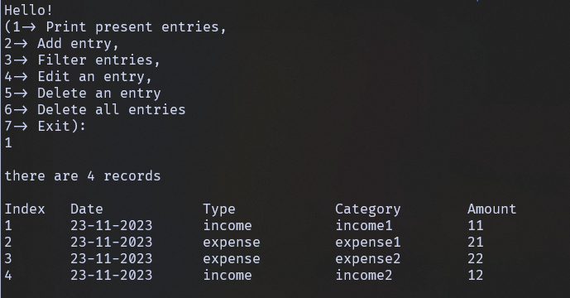
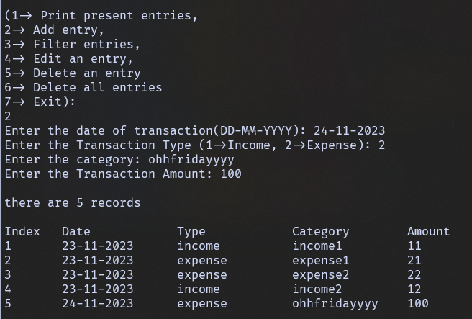
“CodeOutputs”: {
08
Printing entries
Adding entry
c

Slide 22
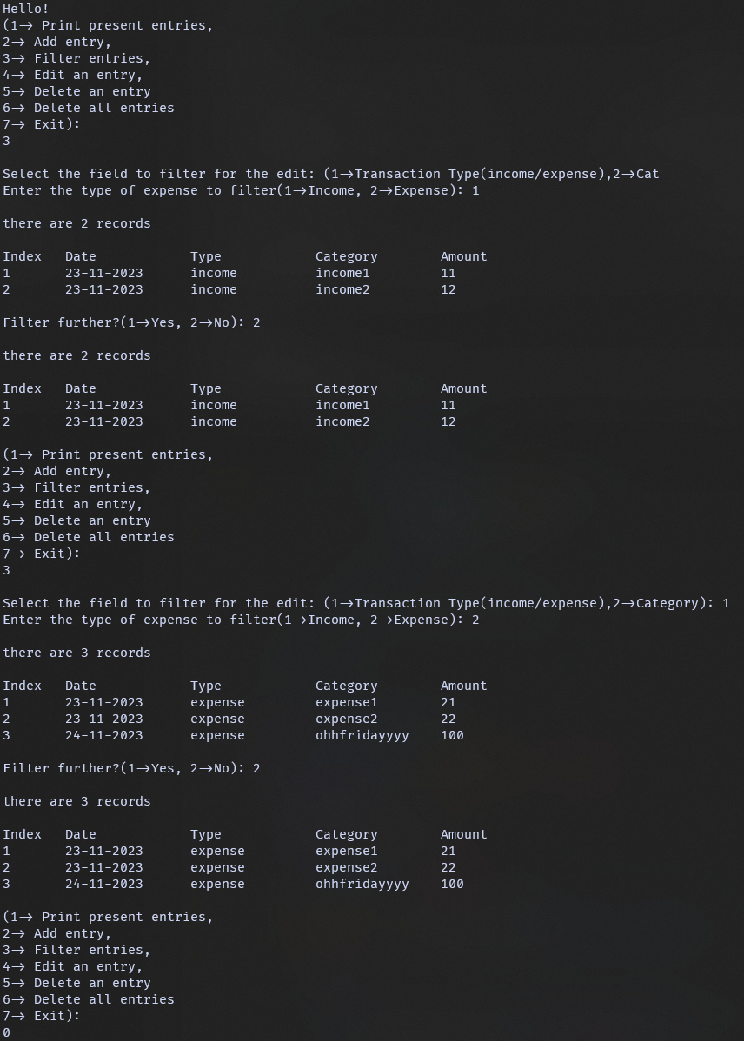
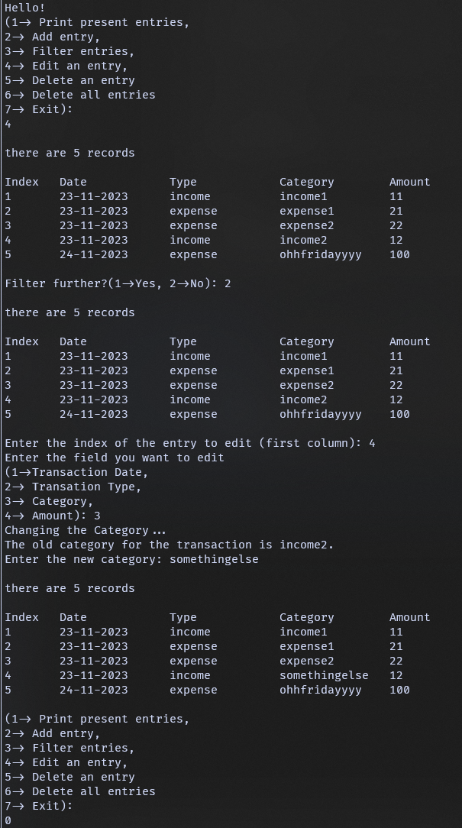
08
Filtering entries
Edinting an entry
c

Slide 23
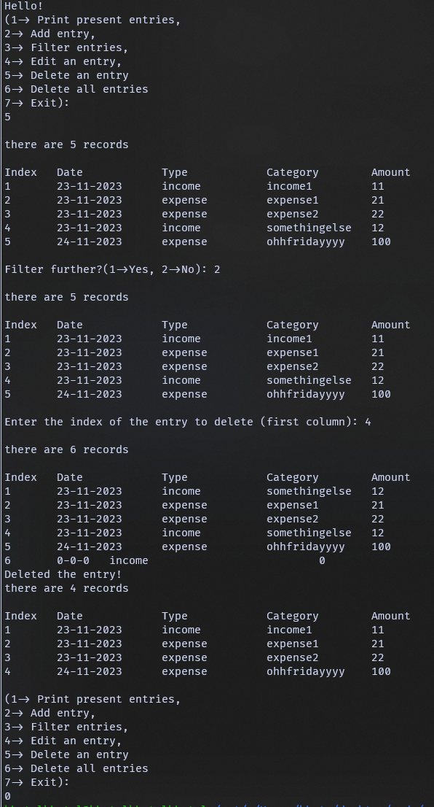
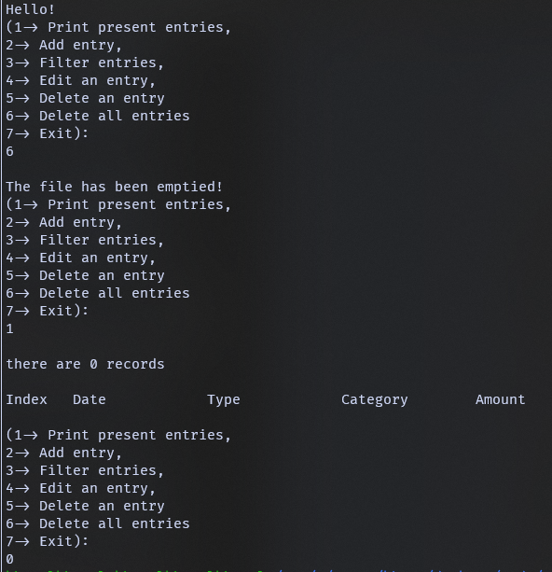
08
Deleting an entry
Deleting all entries
}
<---- my bad :’)
c

Slide 24
“PresentationEnd”: {
Thank You!
< i know boht zyada lamba tha>
< uselessly even >
}

